Slide 1
< React />

Slide 2
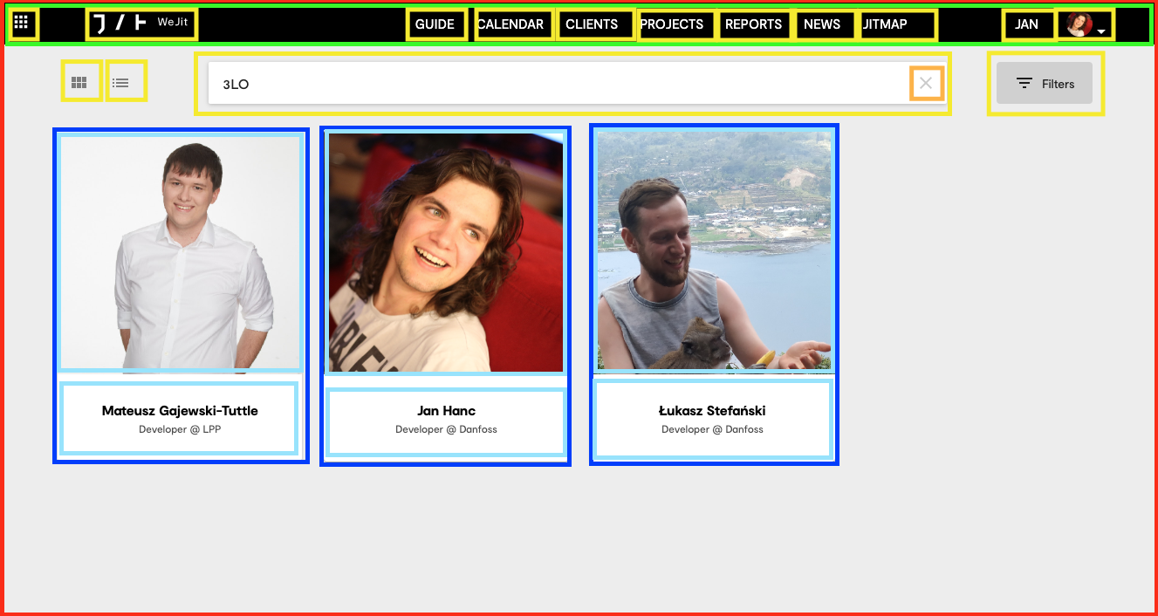
React Components
Small isolated pieces of code
Combined into larger components
Create entire application
Notes:
https://reactjs.org ma przykladowe appki na pierwszej stronie ktorych komponenty nie sa obfuskowane wiec mozna uzyc do demonstracji

Slide 3

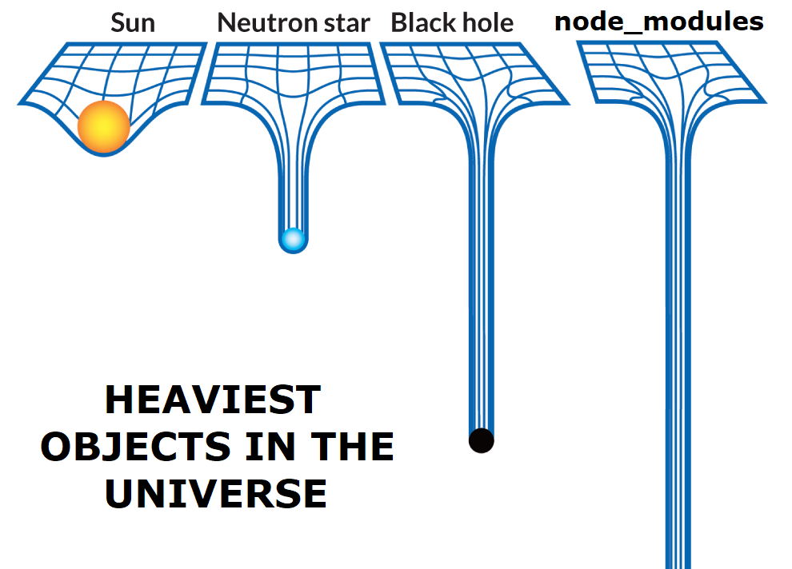

Tools
React devtools
Npm
Node modules
Webpack
Babel
create-react-app
Notes:
Zainstalowac react devtool, do czego sluzy npm webpack I babel – krotko zwiezle I na temat. Nikogo nie obchodzi jak config webpacka czy babela wyglada :P
Stworzyc nowy projekt z uzyciem creat-react-app I omowic co tam jest ;)

Slide 4
JSX
const name = '3LO';
const element = <h1>Hello, {name}</h1>;
const element = <img src={user.avatarUrl} />

Slide 5
Virtual DOM (ReactDOM)
Virtual representation of DOM is kept in memory and synchronized with the actual DOM
We tell React what we want the state of UI to be – no need for attribute manipulation, event handling, and manual DOM updating
We use React elements to represent pieces of user interface
Once React knows which virtual DOM objects have changed, then React updates only those objects, in the real DOM
ReactDOM is a library used by React to handle this operation

Slide 6
Lifecycle hooks
Mounting
constructor()
static getDerivedStateFromProps()
render()
componentDidMount()
Updating
static getDerivedStateFromProps()
shouldComponentUpdate()
render()
getSnapshotBeforeUpdate()
componentDidUpdate()
Unmounting
componentWillUnmount()
Error handling
static getDerivedStateFromError()
componentDidCatch()

Slide 7
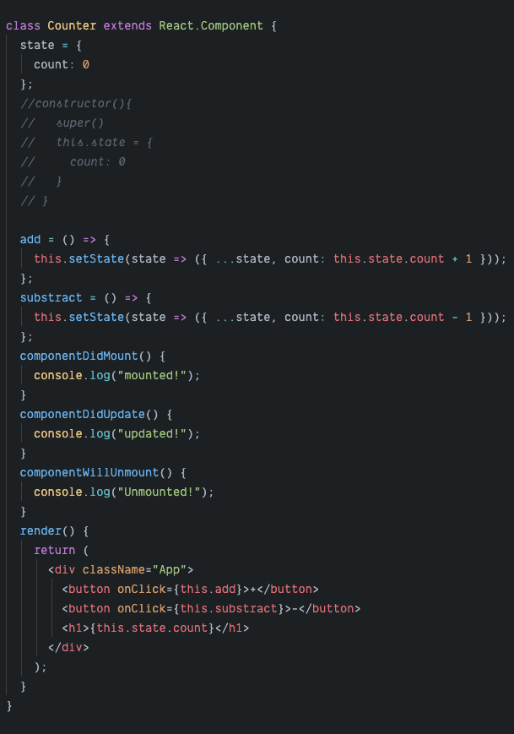
Class components
Render method
Lifecycle hooks
JSX
Props
State
https://codesandbox.io/s/sweet-newton-l4rrt

Slide 8
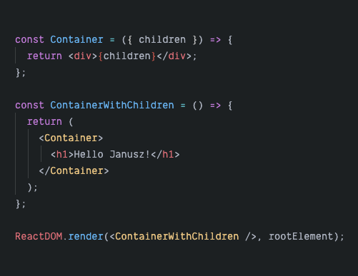
Props - children

Slide 9
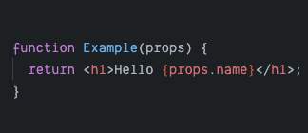
Function components

Slide 10
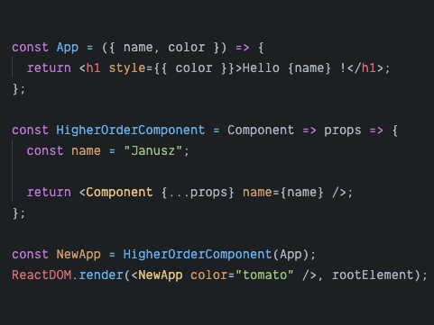
Higher order component ( HOC )

Slide 11
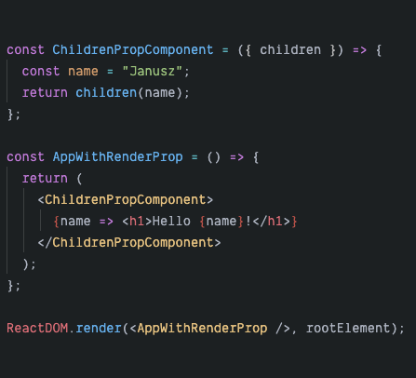
Render children prop

Slide 12
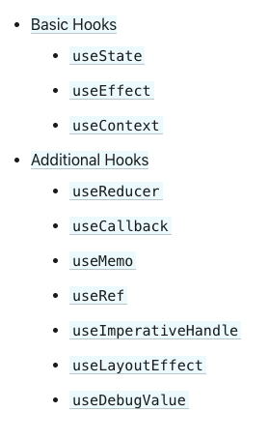
React hooks
Complete overhaul of building react applications
State hook
Effect hook
Callback hook
Memoisation hook
Custom hooks
https://reactjs.org/docs/hooks-overview.html
https://codesandbox.io/s/xenodochial-kirch-ltyg9

Slide 13
One way data flow
function Grandparent(props) {
const handleNameClick = (arg)=>{...}
return (
<Parent
name="Sara"
onNameClick={handleNameClick}
/>
)
}
function Parent(props) {
return (
<Child
name={props.name}
onNameClick={props.handleNameClick}
/>
)
}
function Child(props) {
return (
<div className="itemContainer">
<p>{props.name}</p>
<input onClick={props.onNameClick} />
</div>
)
}
props
props​
event
event

Slide 14
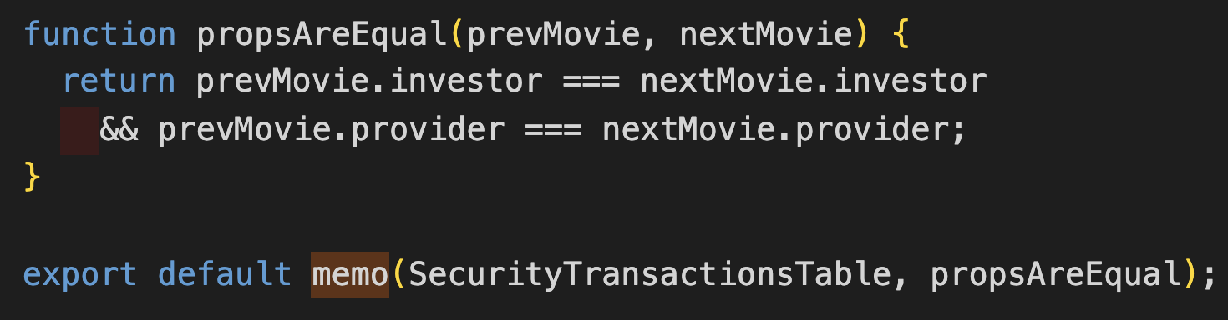
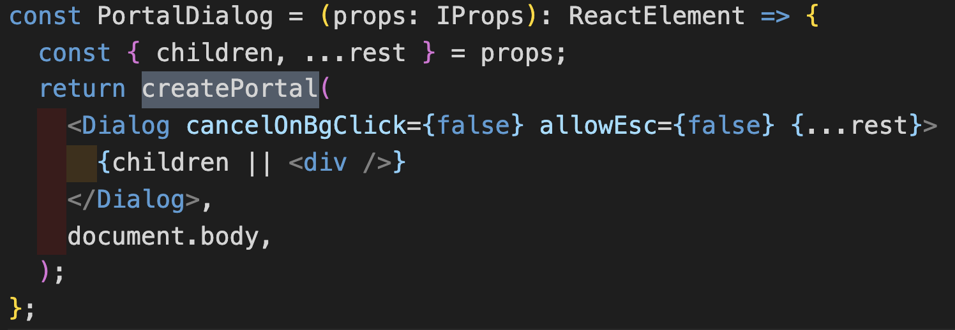
React higher order components
Memo
PureComponent and shouldComponentUpdate for functional components
memoizes the rendered output then skips unnecessary rendering
Portal
allows us to render children in a DOM node which doesn't necessarily exist in the parent's DOM hierarchy
usually used when we want a child to visually “break out” of its container. For example, dialogs, hovercards, and tooltips.
Notes:
SCU bo jako 2 parametr można zadeklarować przy jakim warunku ma się rerenderować

Slide 15
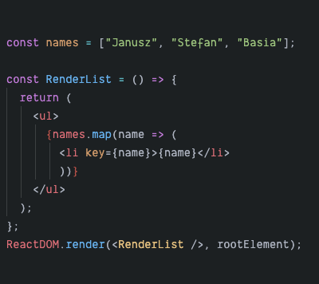
Rendering lists

Slide 16
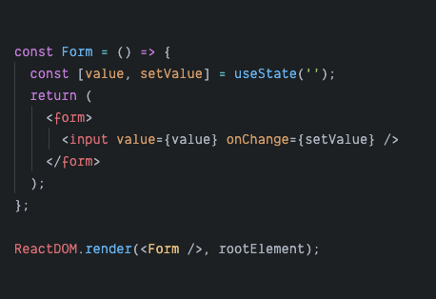
Forms

Slide 17
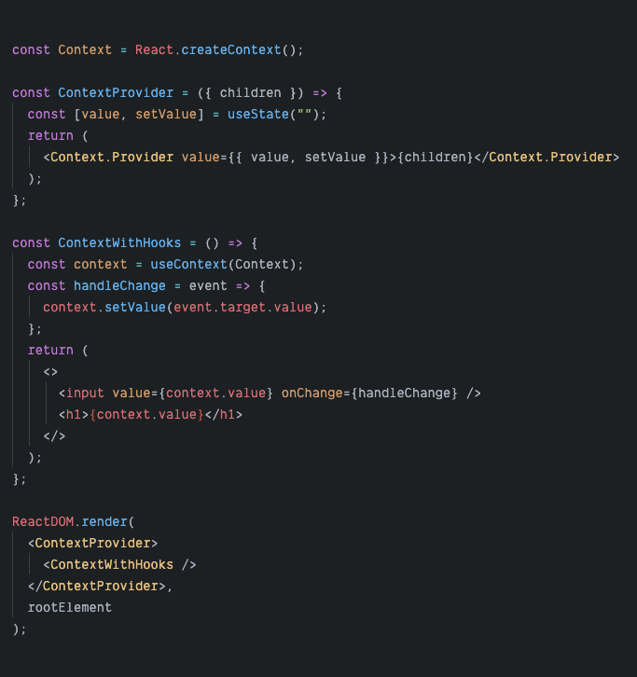
Context
Initialize new context
Create provider
Consume context
Provide context

Slide 18
Styling
CSS
CSS modules
local and global classes – no more name conflicts,
all class names and animation names are scoped locally by default – they apply to this component and nowhere else
CSS in JS
camelCased properties e.g. fontWeight instead of font-weight,
possibility to include logic e.g. height: Platform.OS === 'ios' ? 200 : 100,
hooks compatible https://cssinjs.org/?v=v10.0.0#react-jss-example
Notes:
Napomknac o plusach I minusach kazdej z metod, btw. Jakie sa minusy css in js?

Slide 19
Exercise #1 Pokemon Pokedex
http://pokemontcg.io/
Notes:
indywidualne

Slide 20
Exercise #1 – spacex api
Notes:
Live coding

